Slide 1
RYA Level 1

Slide 2
Cold Water Shock
Key Points:
- You will likely gasp for air, then breath rapidly.
- Can only hold breath for seconds so protect your airway from waves and spray.
- Your heart will be working harder, so don’t try to swim, just relax!
- The effects will be at its worst in the first 30 seconds but will have gone within 3 minute

Slide 3
Weather Sources
Internet
  Windguru
  Met Office
  BBC
Harbour / Marina notice board
Coastguard on VHF
Shipping Forecast
Local radio weather bulletin
Can Pay….
Marine Call
Metfax

Slide 4
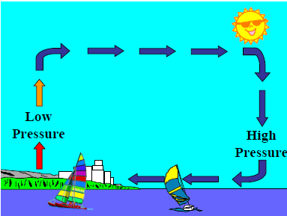
Level 1- On shore breeze

Slide 5
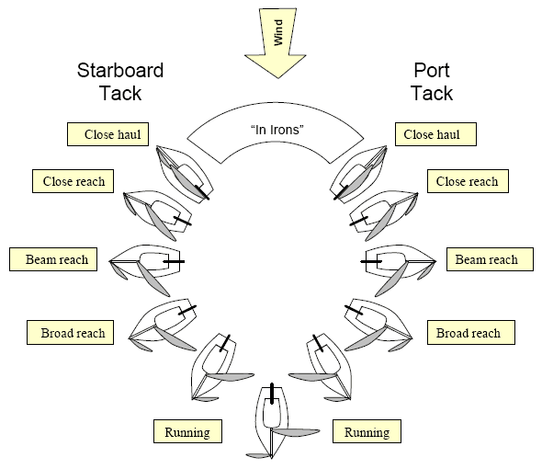
Recap

Slide 6
5 Essentials
Sail Setting
Centreboard
Course made good
Trim
Balance

Slide 7
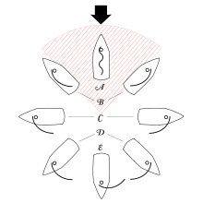
1) Sail setting

Slide 8
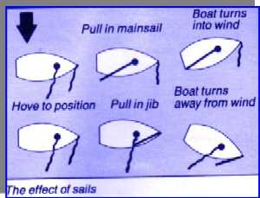
1) Turning using sails
?
?

Slide 9
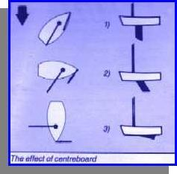
2) Centreboard
Upwind
Across Wind
Down Wind
Sail IN
Centreboard IN
Sail out
Centreboard OUT

Slide 10
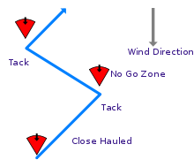
3) Course made good –can’t go upwind

Slide 11
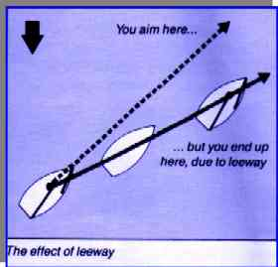
3) Course over ground -slippage
S
Slippage (leeway)
Tide
Force on sail more than the counteracting force on the centreboard
Reducing Slippage
Centreboard fully in the water
Don’t heal the boat
Dig the nose in – sit forward upwind

Slide 12
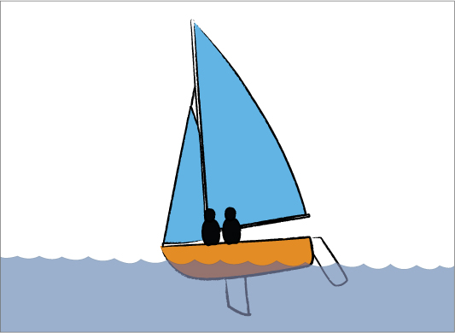
4) Trim (forward and aft)
Upwind – sit forward to dig the front in and stop lateral movement
Off wind – flat is fast
Planing downwind – sit further back to induce planning – raise bow

Slide 13
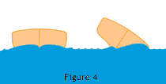
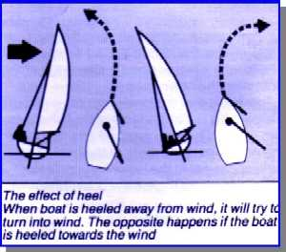
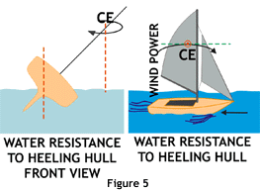
5) Balance
Why does this happen?
Digging in the bow on the lee side produces a bigger bow wave on that side and shoves the boat to windward

Slide 14
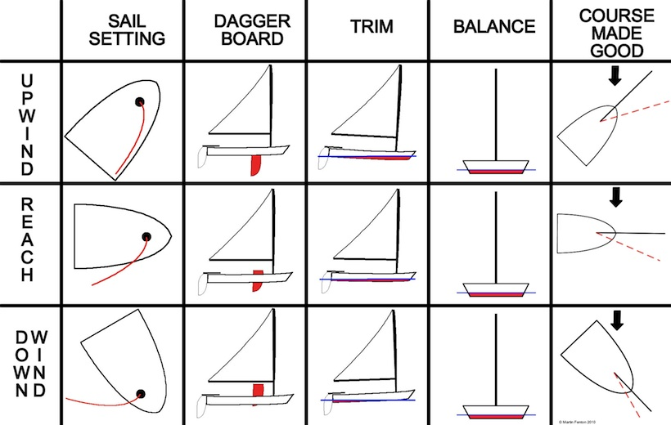
Summary
Flat is fast

