Slide 1
RYA Level 2

Slide 2
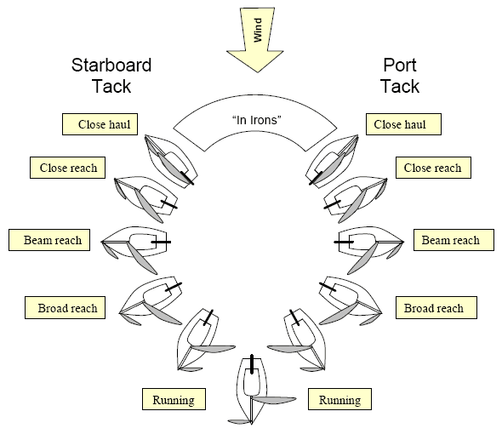
Recap

Slide 3
5 Essentials
Sail Setting
Centreboard
Course made good
Trim
Balance

Slide 4
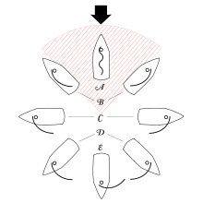
1) Sail setting

Slide 5
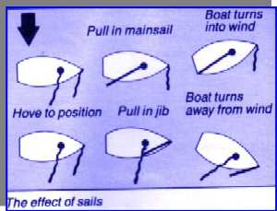
1) Turning using sails
?
?

Slide 6
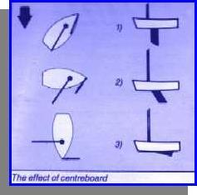
2) Centreboard
Upwind
Across Wind
Down Wind
Sail IN
Centreboard IN
Sail out
Centreboard OUT

Slide 7
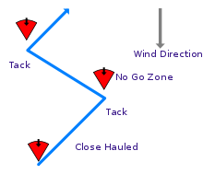
3) Course made good –can’t go upwind

Slide 8
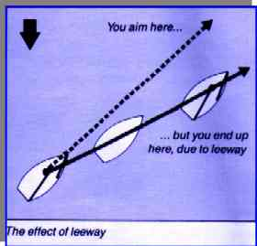
3) Course over ground -slippage
S
Slippage (leeway)
Tide
Force on sail more than the counteracting force on the centreboard
Reducing Slippage
Centreboard fully in the water
Don’t heal the boat
Dig the nose in – sit forward upwind

Slide 9
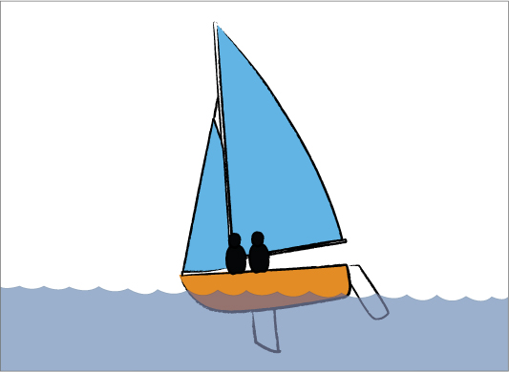
4) Trim (forward and aft)
Upwind – sit forward to dig the front in and stop lateral movement
Off wind – flat is fast
Planing downwind – sit further back to induce planning – raise bow

Slide 10
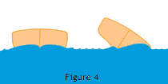
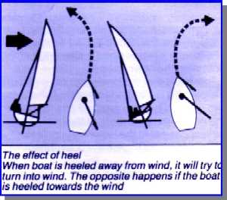
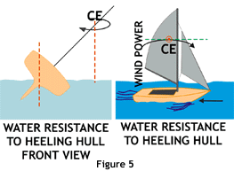
5) Balance
Why does this happen?
Digging in the bow on the lee side produces a bigger bow wave on that side and shoves the boat to windward

Slide 11
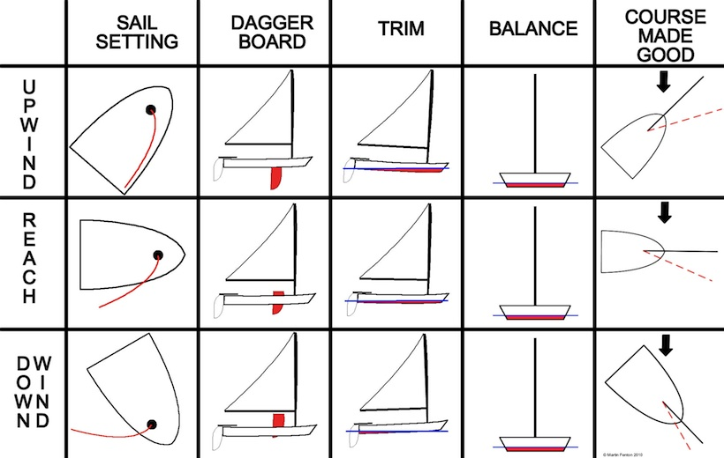
Summary
Flat is fast

Slide 12
Level 2 Day 2

Slide 13
Weather Sources
Internet
  Windguru
  Met Office
  BBC
Harbour / Marina notice board
Coastguard on VHF
Shipping Forecast
Local radio weather bulletin
Can Pay….
Marine Call
Metfax

Slide 14
Weather Sources- Met Office – Shipping forecast
In an ‘ Area’ – ‘Irish Sea’
Wind: Direction and Beaufort Scale. Forecast.
e.g. Northwesterly 4 increasing to 5
Sea State: Slight or moderate
Weather: Showers
Visibility: Good

Slide 15
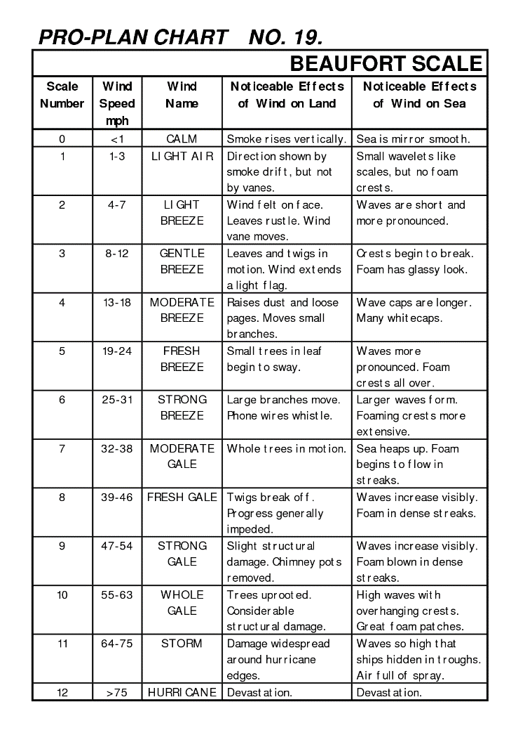

Slide 16
Sea State
WMO Sea State Code | Wave height | Characteristics
0 | 0 metres (0 ft) | Calm (glassy)
1 | 0 to 0.1 metres (0.00 to 0.33 ft) | Calm (rippled)
2 | 0.1 to 0.5 metres (3.9 in to 1 ft 7.7 in) | Smooth (wavelets)
3 | 0.5 to 1.25 metres (1 ft 8 in to 4 ft 1 in) | Slight
4 | 1.25 to 2.5 metres (4 ft 1 in to 8 ft 2 in) | Moderate
5 | 2.5 to 4 metres (8 ft 2 in to 13 ft 1 in) | Rough
6 | 4 to 6 metres (13 to 20 ft) | Very rough
7 | 6 to 9 metres (20 to 30 ft) | High
8 | 9 to 14 metres (30 to 46 ft) | Very high
9 | Over 14 metres (46 ft) | Phenomenal

Slide 17
Met office
http://www.metoffice.gov.uk/public/weather/marine-shipping-forecast/#?tab=map

Slide 18
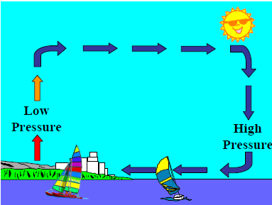
Level 2- On shore breeze

Slide 19
Points of Sail

Slide 20
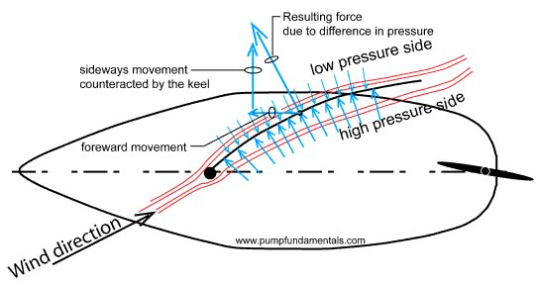
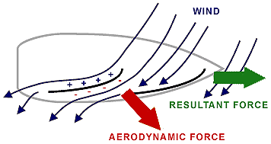
Aerodynamics

Slide 21
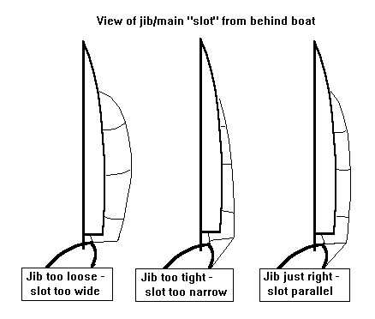
The Slot

Slide 22
Sea Sailing

Slide 23
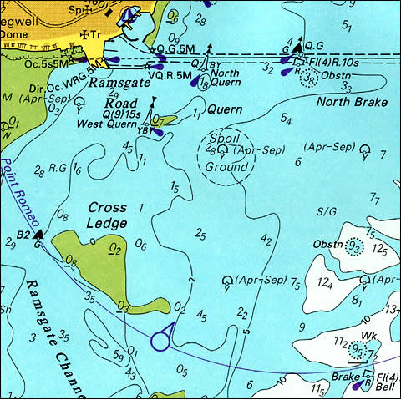
Chart Depths
Chart Depth = Lowest Astronomical tide depth ie worst case scenario. (also known as chart datum)
In this case 6m
Boat may have a draught of 2m, so at this point there is 4m of clearance (worst case) PLUS the height of the tide.

Slide 24
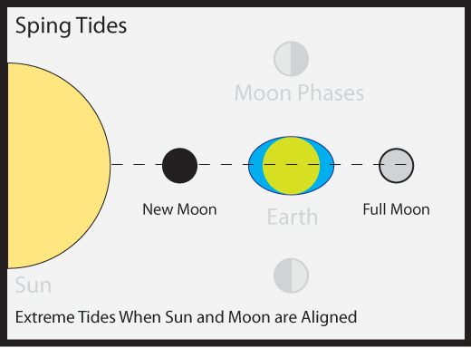
Level 2
Two high and two low tides in 24 Hours

Slide 25
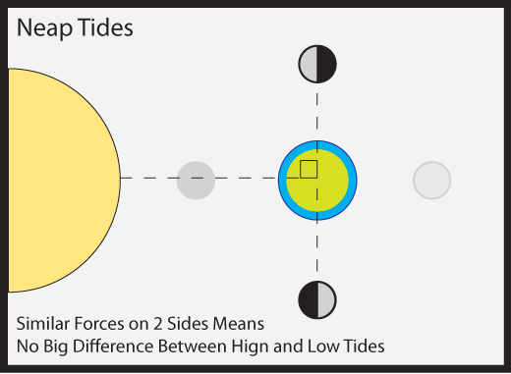

Slide 26
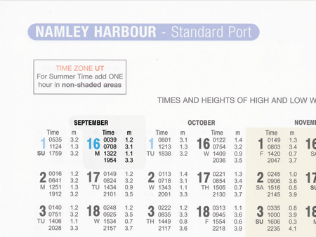
Tide Tables
Give times of High and Low tide, with depth

Slide 27
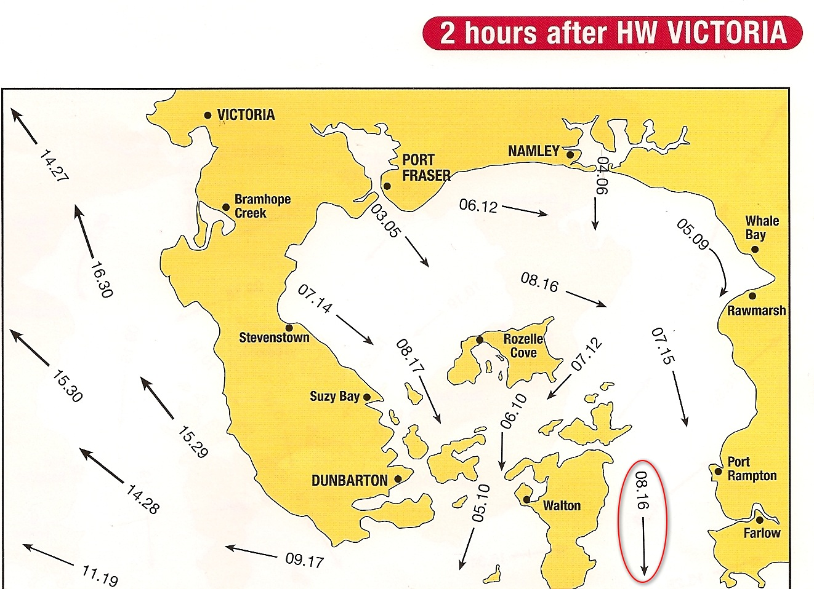
Tidal Stream Atlas
15.29
1.5 knots at Neaps
2.9 knots at Springs

Slide 28
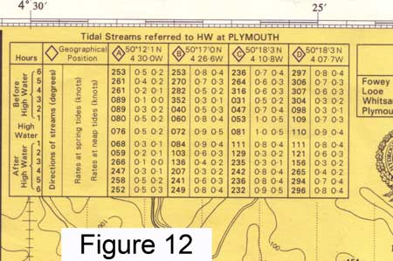
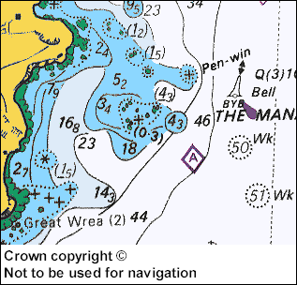

Tidal Stream Tables
Tidal Diamond relates to the Tide Table

Slide 29
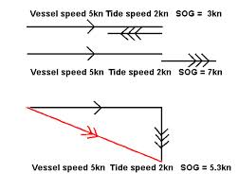
Speed over Ground -SOG

Slide 30
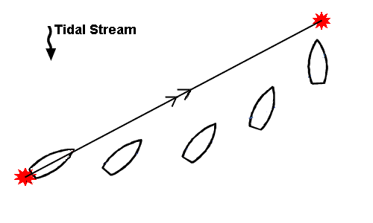
Course over Ground

Slide 31
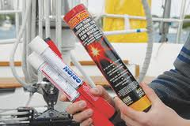
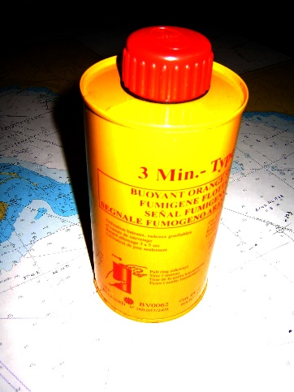
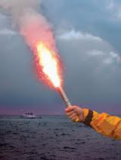
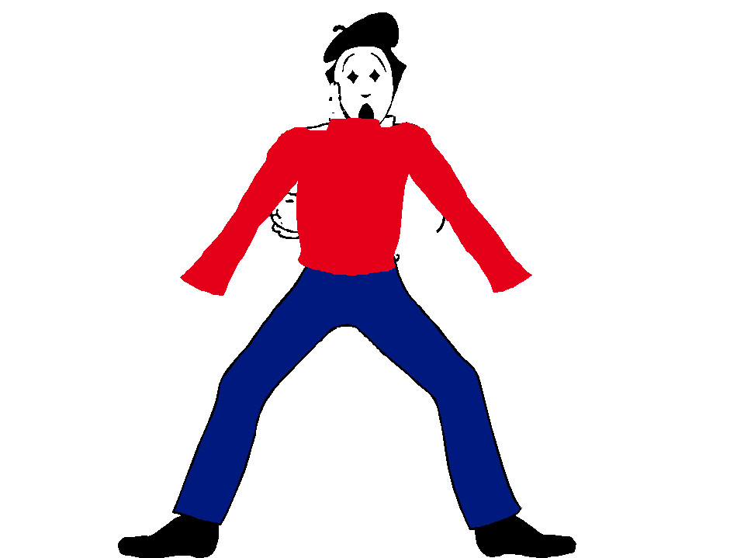
Safety At Sea
Equipment
Paddle
Anchor
  Enough line to reach the bottom
VHF Radio (phone?)
First Aid kit
Summoning Help
Flares
  (know how to use them and keep dry)
  Red parachute (night)
  Orange handheld or launched
  Orange Smoke
Raise and lower arms

Slide 32
Cold Water Shock
Key Points:
- You will likely gasp for air, then breath rapidly.
- Can only hold breath for seconds so protect your airway from waves and spray.
- Your heart will be working harder, so don’t try to swim, just relax!
- The effects will be at its worst in the first 30 seconds but will have gone within 3 minute

